Slide 1
Digital Portfolio
STUDENT NAME : M.Kousar
REGISTER NO & NMID : 2428C0458 & asbru3124aiml01
DEPARTMENT : Bsc (AI&ML)
COLLEGE/ UNIVERSITY : Cheran Arts Scince College/ Bharathiyar University

Slide 2
PROJECT TITLE Watering Reminder

Slide 3


AGENDA
Problem Statement
Project Overview
End Users
Tools and Technologies
Portfolio design and Layout
Features and Functionality
Results and Screenshots
Conclusion
Github Link
3/21/2024 Annual Review

Slide 4

PROBLEM STATEMENT “Small-scale farmers often struggle to keep track of crop watering scheduled, leading to either under-watering or over-watering ,which affect crop yield and resource efficiency. There is a need for a simple, accesible, and offline-friendly web application that helps farmers monitor and manage watering Intervals for different crops based on last watering date and crop type’’ objectives: 1. Build a lightweight web app using Html, css and javaScript. 2. Allow users to select crop type and input last watering date. 3. Calculate and display the next recommended watering date . 4.provide visual cues or alerts when watering Is due.

Slide 5

PROJECT OVERVIEW Goal To Help farmers in Palladam and beyond keep track of crop watering scheduled using a simple , browsers –based tool . Built With Html for structure Css for styling JavaScript for logic and reminders Key Features 1.Select crop type (e.g.,rice , cotton, maize) 2.Input last watering date 3.Get reminder for next watering based on crop –specific intervals 4.Works offline –no login or internet required Why It Matters This tool supports better crop health, saves water , and reduces the stress of remembering schedules manually.

Slide 6

WHO ARE THE END USERS? 1. Small – Scale Farmers 2. AgriCultural Steudent & Student 3. Elderly Farmers 4. Community Volunteers & NGOs

Slide 7

TOOLS AND TECHNIQUES
Tool | Purpose
HTML | Structure of the form, buttons , layout
Css | Styles the Interface for readability and usability
JavaScript | Adds logic to calculate watering intervals and show reminders
Browser Console | For debugging and testing JavaScript Code
Testing Editor (eg., Codepen) | Writing and organizing your code pen
Mobile Browser | Testing responsiveness and offline usability
Local Strorage | Saving Crop data without a backend

Slide 8
POTFOLIO DESIGN AND LAYOUT
“Tech For Every Day Impact’’
feature project (“ what I Learned’’)
Motivations Like For (eg., building formers , Tamil accessibility)
purpose of people reach out easily
Skills List
[HTML , Css , JavaScript , Problem Solving ]
8

Slide 9
FEATURES AND FUNCTIONALITY Crop Selection Last Watering Date Input Smart Reminder Calculation Mobile -Friendly Design Offline Functionality Local Language Support

Slide 10
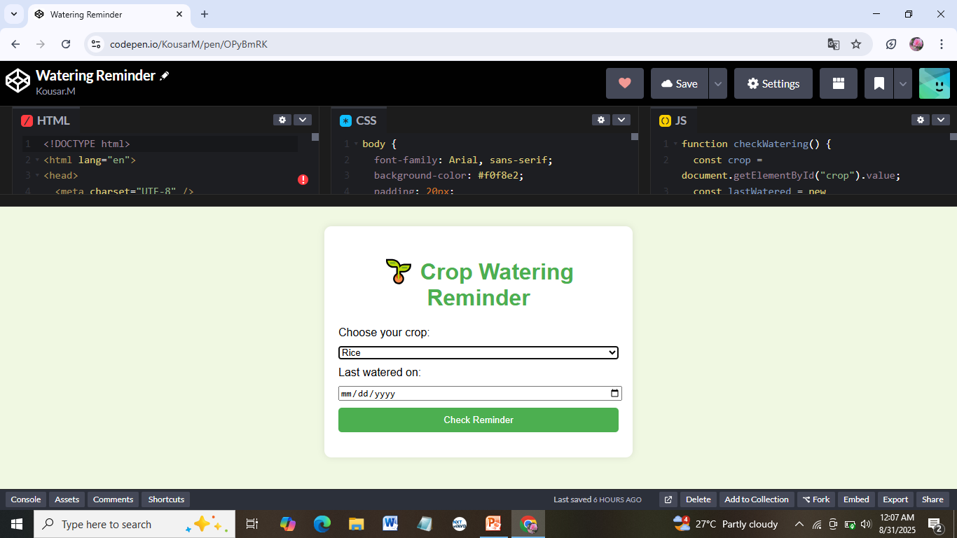


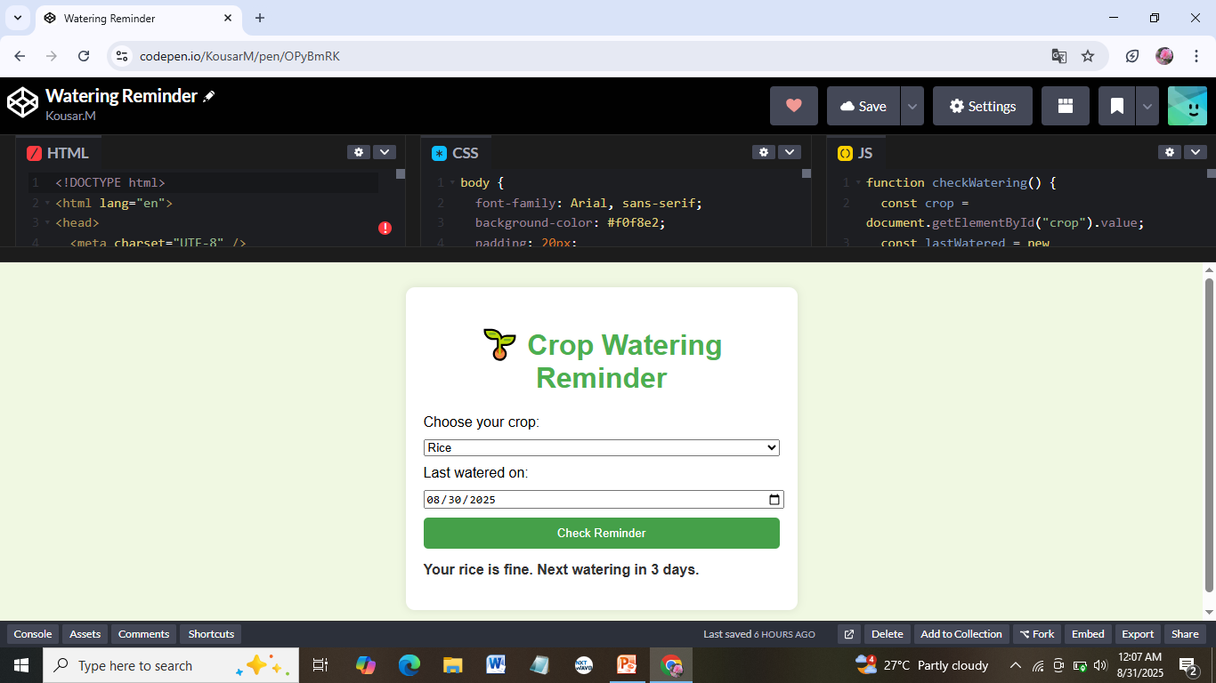
RESULTS AND SCREENSHOTS
3/21/2024 Annual Review
10

Slide 11
CONCLUSION The Crop Watering Reminder Page is a practical, lightweight solution designed to support small–scale farmers in managing their irrigation scheduled more effectively. By combining simple web Technologies-HTML, CSS, and JavaScript-with a users –friendly interfaces , the page empowers users to make timely decision that improve crop health and conserve water. This project reflects your commitment to solving world problems through accessible technology. Its not just a coding exercise –it’s a step toward digital tools that that serve communities , especially in rural areas like Palladam . With future enhancements like Tamil language support and offline data storage, this page can grow into a vital resource for farmers across regions
11

